Slide 1
Convolutional networks
Deep Learning: Bryan Pardo, Northwestern University, Fall 2020
Notes:
Rosenblatt, Frank. "The perceptron: A probabilistic model for information storage and organization in the brain." Psychological review 65.6 (1958): 386.

Slide 2
How big is that image?
500
1000

Slide 3
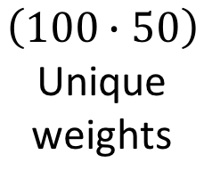
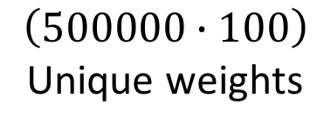

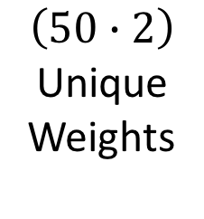
How many weights in a fully connected net?
Input
Layer
Hidden
Layer
Hidden
Layer
Output
Layer
$$\left(100∙50\right)$$
Unique
weights
$$\left(50∙2\right)$$
Unique
Weights
M = 500
$$\left(500000∙100\right)$$
Unique weights
100
Nodes
50
Nodes
2
Nodes
N = 1000
$50,000,000+5,000+100=50,$005,100 weights

Slide 4
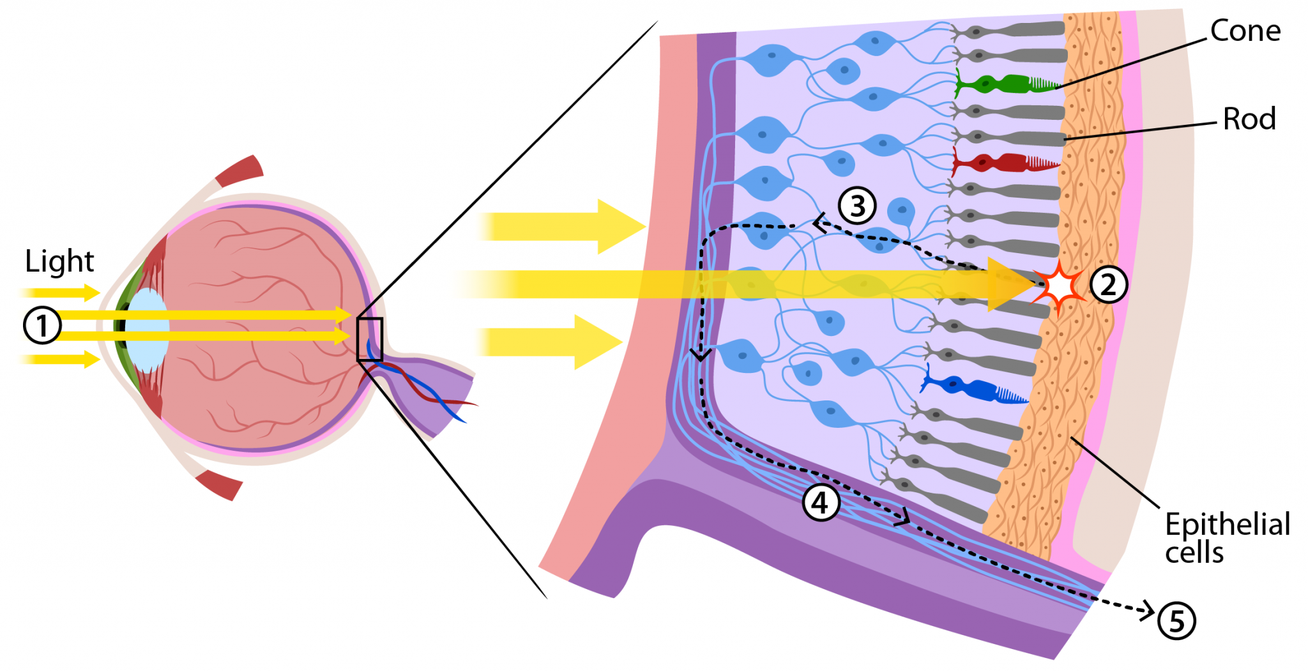
How does the eye do this?
Image from https://askabiologist.asu.edu/rods-and-cones

Slide 5
Limited receptive fields, at multiple levels
Image from https://askabiologist.asu.edu/rods-and-cones

Slide 6
Small Fixed Windows (filter size/receptive field)
If important features fall within a bounded size region, we can bound the receptive field of each unit to that size.
This greatly reduces the number of weights.

Slide 7
Shared weights
If a feature is good to find in one region, it may be good to find in other regions.
Units look for the same feature if they share weights.
A set of units that share weights is a feature map (aka ”channel”)

Slide 8


Building that feature map
Input X
The shared weights W
(AKA: filter or kernel or feature)
Filtered values
$$=$$
Feature map
A shared activation function
$$f\left(x\right)=w^{T}x$$

Slide 9

Building that feature map
Input X
The shared weights W
(AKA: filter or kernel or feature)
Filtered values
$$=$$
Feature map
A shared activation function
$$f\left(x\right)=w^{T}x$$

Slide 10
Building that feature map
Input X
The shared weights W
(AKA: filter or kernel or feature)
Filtered values
$$=$$
Feature map
A shared activation function
$$f\left(x\right)=w^{T}x$$

Slide 11
Building that feature map
Input X
The shared weights W
(AKA: filter or kernel or feature)
Filtered values
$$=$$
Feature map
A shared activation function
$$f\left(x\right)=w^{T}x$$

Slide 12
Multiple Feature Maps
To look for multiple features, use multiple feature maps.
Each map will specialize on one thing.
Even with many feature maps, you still have far fewer weights

Slide 13
Stride
How many units you move with each step of your filter/kernel

Slide 14
Let’s make that stride = 2
Input X
The shared weights W
(AKA a filter, AKA a feature)
Filtered values
$$=$$
Feature map
A shared activation function
$$f\left(x\right)=w^{T}x$$

Slide 15
Let’s make that stride = 2
Input X
The shared weights W
(AKA a filter, AKA a feature)
Filtered values
$$=$$
Feature map
A shared activation function
$$f\left(x\right)=w^{T}x$$

Slide 16
Let’s make that stride = 2
Input X
The shared weights W
(AKA a filter, AKA a feature)
Filtered values
$$=$$
Feature map
A shared activation function
$$f\left(x\right)=w^{T}x$$

Slide 17
Let’s make that stride = 2
Input X
The shared weights W
(AKA a filter, AKA a feature)
Filtered values
$$=$$
Feature map
A shared activation function
$$f\left(x\right)=w^{T}x$$

Slide 18
Padding
Extra blank rows and columns added around your input.

Slide 19


Stride = 2, Padding = 1
Input X
The shared weights W
(AKA a filter, AKA a feature)
Filtered values
$$=$$
Feature map
A shared activation function
$$f\left(x\right)=w^{T}x$$

Slide 20
Stride = 2, Padding = 1
Input X
The shared weights W
(AKA a filter, AKA a feature)
Filtered values
$$=$$
Feature map
A shared activation function
$$f\left(x\right)=w^{T}x$$

Slide 21
Stride = 2, Padding = 1
Input X
The shared weights W
(AKA a filter, AKA a feature)
Filtered values
$$=$$
Feature map
A shared activation function
$$f\left(x\right)=w^{T}x$$

Slide 22
Stride = 2, Padding = 1
Input X
The shared weights W
(AKA a filter, AKA a feature)
Filtered values
$$=$$
Feature map
A shared activation function
$$f\left(x\right)=w^{T}x$$

Slide 23
Dilation
Space out the squares of the filter on your input.

Slide 24
Stride = 2, Padding = 1, Dilation = 2
Input X
The shared weights W
(AKA a filter, AKA a feature)
Filtered values
$$=$$
Feature map
A shared activation function
$$f\left(x\right)=w^{T}x$$

Slide 25
Stride = 2, Padding = 1, Dilation = 2
Input X
The shared weights W
(AKA a filter, AKA a feature)
Filtered values
$$=$$
Feature map
A shared activation function
$$f\left(x\right)=w^{T}x$$

Slide 26
Stride = 2, Padding = 1, Dilation = 2
Input X
The shared weights W
(AKA a filter, AKA a feature)
Filtered values
$$=$$
Feature map
A shared activation function
$$f\left(x\right)=w^{T}x$$

Slide 27
Channels
Convolutional layer with 5 channel output
RGB 3-color input has 3 channels
Convolutional layer with 2 channel output

Slide 28
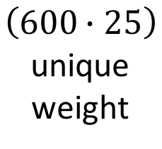

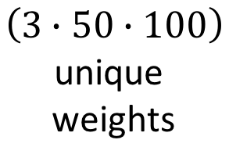

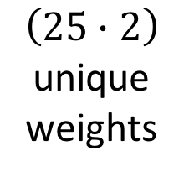
How many weights in a convolutional net?
3 feature maps
of 200 nodes.
Receptive fields: 50 by 100
Input
Layer
Fully connected
layer of 25 nodes
2 fully
connected nodes
M = 500
$$\left(3∙50∙100\right)$$
unique
weights
$$\left(600∙25\right)$$
unique
weight
$$\left(25∙2\right)$$
unique
weights
N = 1000
$15,000+15,000+50=30$,050 unique weights
Compare that to the $50,$005,100 weights in the other network

Slide 29
Is that enough reduction?
That picture of the adorable Capybara was 500,000 pixels.
The 2017 iPhone X takes 12 megapixel images. That’s 24 times as big.
Making the network on the previous slide 24 times bigger would have us at over 600,000 weights.
Can we do some kind of down sampling on our data?

Slide 30

Max Pool Layer: A kind of downsampling
Max Pool
$$f\left(x\right)=max⁡(x_{1},x_{2},…x_{n})$$
LAYER N LAYER N+1

Slide 31
Max Pool Layer: A kind of downsampling
Max Pool
$$f\left(x\right)=max⁡(x_{1},x_{2},…x_{n})$$
LAYER N LAYER N+1

Slide 32
Max Pool Layer: A kind of downsampling
Max Pool
$$f\left(x\right)=max⁡(x_{1},x_{2},…x_{n})$$
LAYER N LAYER N+1

Slide 33
Max Pool Layer: A kind of downsampling
Max Pool
$$f\left(x\right)=max⁡(x_{1},x_{2},…x_{n})$$
LAYER N LAYER N+1

Slide 34
Max Pool Layer: A kind of downsampling
Max Pool
$$f\left(x\right)=max⁡(x_{1},x_{2},…x_{n})$$
LAYER N LAYER N+1

Slide 35
Other kinds of pooling
Min pooling
Average pooling
When would you want to use each of these? How would you pick?

Slide 36
Reduce your patch size, if you can
Use a small patch of the spectrogram as input (e.g. 100 by 100 patch of the spectrogram)
Reduces the number of model parameters needed
Increases the number of training examples
1000 Spectrograms * 600 patches* 100augmentations = 60 million

Slide 37
So…what is a convolutional net?
A network with one or more layers that are feature maps
A layer with feature maps is called a “convolutional layer”
Often, convolutional layers are alternated with pooling layers.
Since these nets have many fewer connections
They train faster
They need fewer training examples

